Slide 1

Salesforce Industries

Slide 2

Introduction
Salesforce Vlocity, now known as Salesforce Industries, is a set of industry-specific cloud-based applications built on the Salesforce platform
Salesforce acquired Vlocity on February 25, 2020.

Slide 3
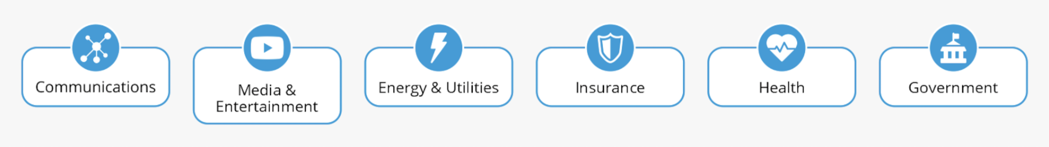
Salesforce for Various Industries

Slide 4
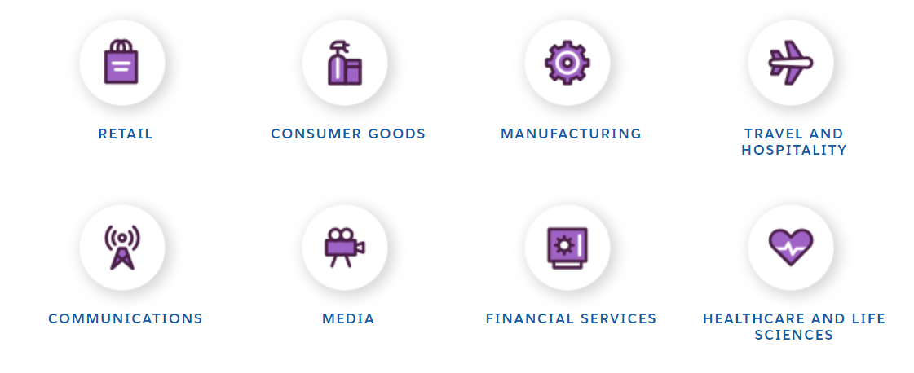
Salesforce for Various Industries

Slide 5

Retail
Salesforce Retail and ecommerce CRM helps modern-day sellers to identify consumer needs and preferences. It has features for every team—sales, marketing, and customer service—helping them respond in real-time with an informed message. Salesforce ecommerce B2B or B2C streamlines business processes by connecting everyone with the information they need to build and provide the right products or services. By using Salesforce Ecommerce Cloud/Salesforce Retail Cloud, businesses will be able to reach customers faster.

Slide 6

Consumer Goods
This unique service offered by Salesforce helps businesses operating in the consumer goods industry to boost their growth rate and return on investment using industry-specific tools and features. Consumer Goods Cloud is currently being used by various enterprises related to food, personal care, beauty, and many other related sectors. Businesses use Consumer Goods Cloud to effectively manage their trade promotions and funds using impactful insights generated by the platform.

Slide 7
Retail
Salesforce Retail and ecommerce CRM helps modern-day sellers to identify consumer needs and preferences. It has features for every team—sales, marketing, and customer service—helping them respond in real-time with an informed message. Salesforce ecommerce B2B or B2C streamlines business processes by connecting everyone with the information they need to build and provide the right products or services. By using Salesforce Ecommerce Cloud/Salesforce Retail Cloud, businesses will be able to reach customers faster — offering seamless omnichannel experiences both online and in the store.

Slide 8

Manufacturing
Salesforce Manufacturing Cloud is a cloud-based platform that enables companies to manage their manufacturing processes and data in one place. It's designed to help you improve processes and increase productivity by simplifying the way you do business.
The Salesforce Manufacturing Cloud brings together all of your company's manufacturing data, including customer orders and product inventory, into one central location. This means that rather than having to manage multiple systems for each step of your process, you can see everything in one place—and it helps you make better decisions about how to run your business.

Slide 9

Travel and Hospitality
Salesforce has developed this service specifically for the tourism industry to enable businesses to provide personalized services to their customers to increase their loyalty and satisfaction. The Salesforce CRM of tourism displays all the details of customers, including travel history, in a single dashboard, allowing users to make impactful conversations with customers. The platform displays a unified view of customer interests and preferences that helps users to bring in new customers. It comes with a loyalty management feature that lets businesses build impactful B2B and B2C programs that are configurable and can be deployed quickly.

Slide 10

Communications
Salesforce Communications Cloud is a service that comes with pre-built data models and communication capabilities that allow users to have seamless communications with B2B, B2C, and wholesale service providers. Communications Cloud has highly customizable modular basic service sets (BSS) that meet the telecom industry standards.
The service enables businesses to quickly launch personalized offers for customers, which significantly increases companies’ digital presence and engagement. It uses artificial intelligence to provide features like automated personalized SMS and emails that help increase customer satisfaction. The service also bags powerful predictive analytics tools to allow users to make better strategic decisions.

Slide 11

Media
Salesforce meticulously designed Media Cloud to cater to the needs of the media and entertainment industry. Media Cloud eliminates the need for coding to carry out various tasks as it has drag and drop capabilities. It comes with media industry-specific data models.
Media Cloud also helps businesses to effectively run advertisement campaigns by providing key metrics like target audience demographics, customer history, and several other features that aid businesses to accelerate their sales and increase customer lifecycle value. Companies can achieve higher advertisement revenue by using Media Cloud’s features like automated pricing, discounts, and other media-specific processes. The platform uses artificial intelligence to generate accurate customer predictions and insights.

Slide 12

Financial Services
Financial Service Cloud (FSC) is a service offered by Salesforce that provides users access to real-time critical customer metrics like previous purchases, customer profile, history, and lots more that enables companies to build impactful relationships with their customers. A better relation ensures increased revenue generation. Availability of relevant insights helps users to adopt need-based selling practices. The service also allows banks to automate and track commercial lending progress.

Slide 13

Healthcare and Life Sciences
Health Cloud is a solution developed by Salesforce that is specifically designed to take care of all the CRM needs for businesses working in the healthcare and life sciences industry. Salesforce Health Cloud is a HIPPA certified platform, which ensures the best possible security for patients’ data.

Slide 14
Salesforce vs Salesforce Industries
Salesforce | Salesforce Industries
Generic data model/ requires building custom objects | Industry data model/reuse standard objects vs building own
No pre-built industry specific processes | Pre-built common industry specific processes
No product catalogue industry standards | Product catalogue optimized per industry standards
Flows-generic requires customization per industry | Omnistudio-Guided omnichannel flows

Slide 15
Benefits of Salesforce Industries(Vlocity)
Increased Sales and Services
Accelerate “Time to Market”
Efficient Business operations
Reduce “Average Handling Time”
Reduce”Quote to Order” Cycle Time

Slide 16
OmniStudio
With OmniStudio, you can create experiences with guided interactions for your customers and agents and with data from your Salesforce org and external sources. And you can do it with drag-and-drop setup and low-code tools. OmniStudio is available to select Industry Cloud customers.

Slide 17
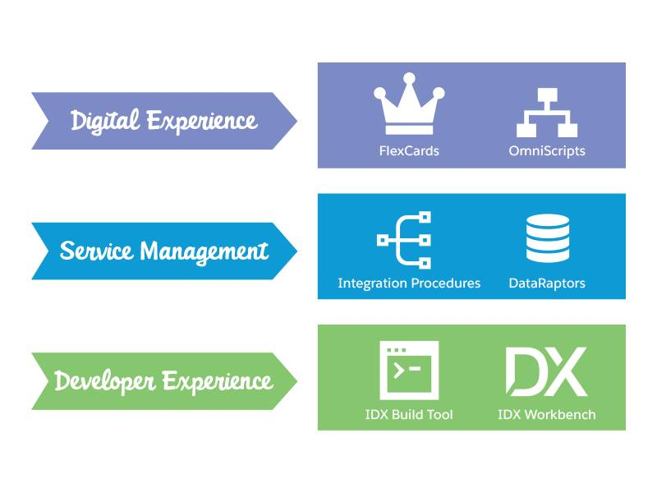
Layers of Components of OmniStudio

Slide 18
Digital Experience
The Digital Experience layer includes two primary user interface (UI) components.
FlexCards — Display contextual information and provide access to relevant tasks for the displayed data.
OmniScripts — A guided path to complete a business process

Slide 19
The Service Management Layer
The Service Management layer includes data services that read, write, transform, calculate, and track data within and outside of Salesforce.
DataRaptors — Configurable services for retrieving, transforming, and updating data
Integration Procedures — Declarative, server-side processes that execute multiple actions in a single server call

Slide 20
The Developer Experience Layer
The Developer Experience layer is an application lifecycle layer of tools for developers to manage and move OmniStudio component changes between environments. These developer tools are:
IDX Workbench Desktop application that enables developers to migrate Datapacks and Salesforce metadata from one org to another or from an org to a Git repository
IDX Build Tool — Command-line automation tool that packages and migrates OmniStudio Datapacks in a source-control-friendly format

Slide 21
FlexCards
Flexcards allow us to build customer-centric, industry-specific UI components and applications on the Salesforce platform and beyond. The FlexCard component contains a combination of data and links to processes within a specific context based on the data source. By default, a FlexCard loops through records returned from its data source and displays the list of records in containers called cards. An active FlexCard component published on a Lightning or Community page.
For example, in a call center scenario, when a call center agent interacts with a customer over the phone, the agent views the customer's information and launches guided processes from the FlexCard during the call.

Slide 22
Advantaged of FlexCards
Viewable on any device.
Can display data from multiple data sources.
Built Quickly Using drag and drop elements. Embeddable in other flexcards
Embeddable inside an LWC Omniscript
Can display more details on demand
Can have Multiple States that Display based on conditions

Slide 23
OmniScripts
An OmniScript allow you to build a guided path for completing a business process and serves as a configurable way of creating a seamless customer experience. You can create OmniScripts using an intuitive drag-and-drop editor that enables you to group various elements such as actions (extract data, send email), functions (formulas), input fields, and branching logic.
For example, consider if a customer wants to:
View and update their contact information, which is stored in Salesforce.
View their service plan, which is stored in a database.
View their bill, which is stored in a billing system; choose to pay it; and select a specific way to pay it.

Slide 24
Advantages of OmniScript
Drag and drop with no or low code
Rapid prototyping, with built in troubleshooting tools
Ease of maintenance
Integrating data from almost any source

Slide 25
DataRaptors
A DataRaptor is a mapping tool that enables you to read, transform, and write Salesforce data. There are four types of DataRaptor: Turbo Extract, Extract, Load, and Transform. Here are some guidelines for determining which DataRaptor to use.

Slide 26
DataRaptors
DataRaptor Turbo Extract : Get data from a single Salesforce object. Simpler configuration
Better performance at runtime
DataRaptor Extract : Get data from one or more Salesforce objects DataRaptor. Extracts read Salesforce data and return results in JSON, XML, or custom formats. You can filter the data and select the fields to return

Slide 27
DataRaptors
DataRaptor Load: Save data to one or more Salesforce objects. Convert JSON input to XML output, and vice versa. Restructure input data and rename fields
DataRaptor Transform: Manipulate any data that comes from inside or outside Salesforce . DataRaptor Loads accept data in JSON, XML, or custom input formats and write the data to Salesforce objects.

Slide 28
Integration Procedures
Integration Procedures are a way to retrieve, save, and manipulate data behind the scenes. An Integration Procedure is also recommended when you need fast processing of complex data from multiple sources.

Slide 29
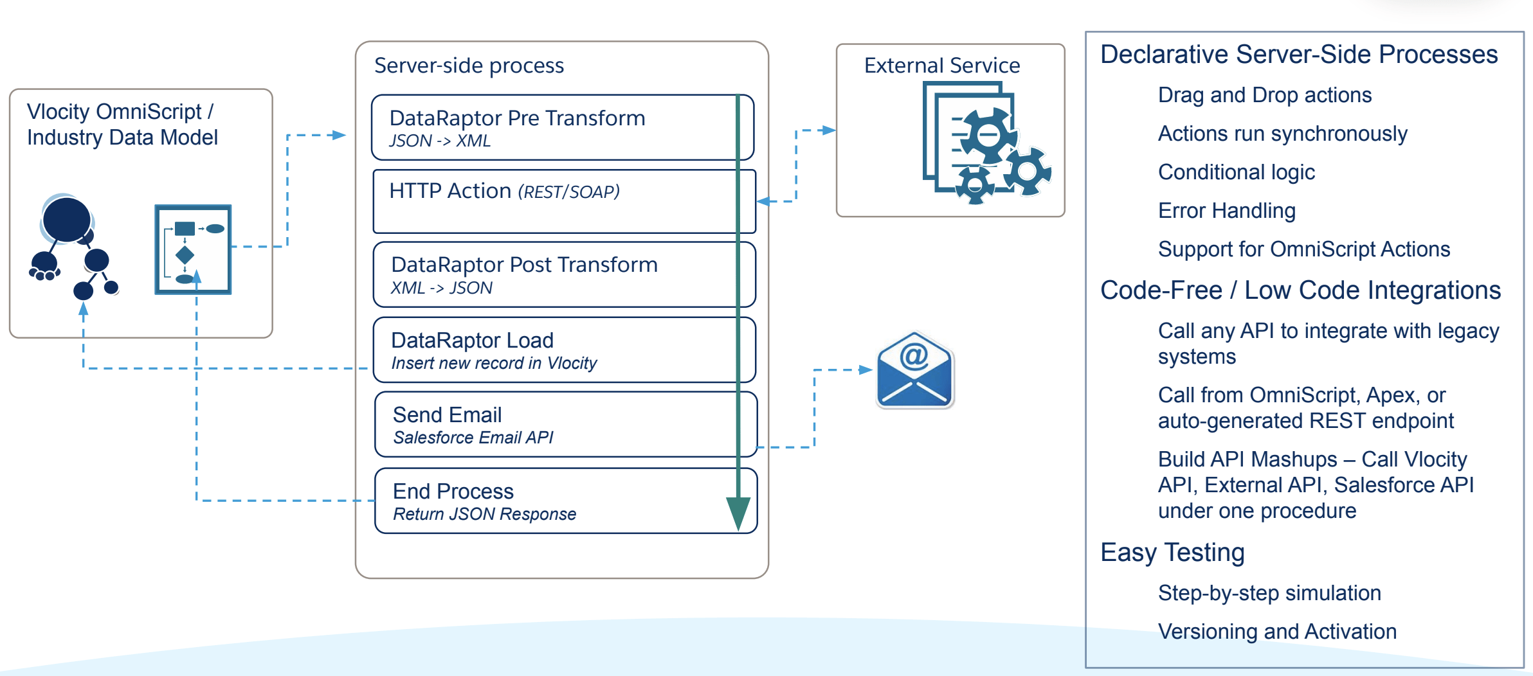

Slide 30
capabilities
Integration Procedures handle multiple data sources
Integration Procedures serve as data sources for multiple technologies
Integration Procedures are portable
Integration Procedures only send and receive the data you need
Integration Procedures perform batch processing

Slide 31

Thank You

